Slide 1

Student INFOSEC TEAM
SIT@FPU

Slide 2
Meeting Agenda
Introduction and Club Vision – Jeremy Eudy
Information Security in 2019 – Alison Hart
Independent Learning – Caleb Shepard
Introductions – Jose Placeres
The Shell – Caleb Shepard
Q & A – SIT Members

Slide 3
Club Vision

Slide 4
Vision of the Student Infosec Team
Create a community of students dedicated to improving themselves and the environment around them, specifically by creating a peer learning environment.
Enable students to learn skills to perform Information Security exercises competitively.
Enable students to excel in the workplace, in their internships, and in professional interactions.

Slide 5
Why Infosec (subjective terminology)
The Information Security world respects and recognizes the terminology “Infosec”.
The term “Cybersec” has more sex appeal but is not respected.
The term “Cybersec” implies that physical security is not included in this area of study. Information Security requires a consistent and holistic philosophy when designing secure systems in any real environment.

Slide 6
Information Security in 2019
BUSINESS AND MILITARY NEEDS

Slide 7
Business Security Needs
All corporations have need of information security, as seen by major leaks in 2017 and 2018
Any business that handles sensitive data, i.e. ALL of them, should be aware of their security policy’s coverage
To protect a large, evolving, corporate entity, security professionals need significant understanding in all areas of Computer Science
Without understanding how the pieces fit together, it’s hard to ensure security for the whole

Slide 8
Military and Government Needs
Cybersecurity is still considered a new field, and the military is playing catch-up
The DoD is constantly seeking new security experts, for national and international tasks
Require all skillsets, often seeking those with offensive knowledge and experience

Slide 9
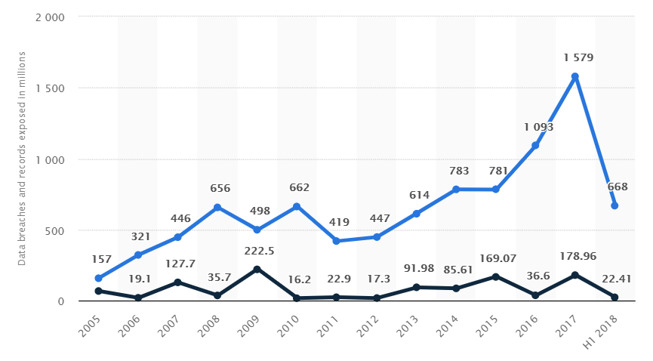
Security Breaches Over the Years
Healthcare breaches
Equifax
Education
San Diego Hack
Government
2018 University-Government breach

Slide 10
Defensive Security
Most infosec jobs available focus on defensive security.
There is a fear of losing information, having information extracted by unauthorized parties, or getting “hacked”
These involve positions relating to application security, network security, and physical security
Policymaking is a meta job in defensive security

Slide 11
Offensive Security
Offensive security normally involves some sort of “penetration testing”
At SIT and SIT events, there will be CTF (Capture the Flag) competitions
CTFs involve retrieval of some key or piece of information
Sometimes there is more than one way to access or find the key
Many CTFs have multiple challenges and offer points for completing challenges
<CTF Story Time> (Caleb Shepard)

Slide 12
Independent Learning
THE IMPORTANCE OF SELF STUDY AND WHERE TO FIND RESOURCES

Slide 13

How to effectively self-study
Reduce and Eliminate DISTRACTIONS
Pick A Spot Where you can learn consistently
Set Goals And Create A Plan

Slide 14


Make a Plan
Determine the skills that you need to acquire
1
Set deadlines for learning milestones, register for classes, form a study group with like-minded people
2
Practice, study and discuss content with peers,
3

Slide 15
Information on Certifications
Certifications show that you have completed standardized programs designed to test competency in a specific topic valued by industry.
Certification programs are robust and offer learners a chance to complete programs made to help them learn a skill beyond an elementary understanding.
Certifications so not take long to learn and may be the most concise programs a learner can participate in to learn a skill.
Certifications show employers that time spent on job training will be minimal and give them a clear picture of your aptitudes.
Polk State offers IT certification programs. Each program is worth three college credits and takes up the same amount of study time as a regular three credit class.
Online certification programs are available and allow learners to work ahead or work on their own time.
Santa Fe College in Gainesville has an online IT program with security and networking certifications. A student may apply and complete these programs online, which may be favorable for students that cannot or do not want to drive between institutions.

Slide 16
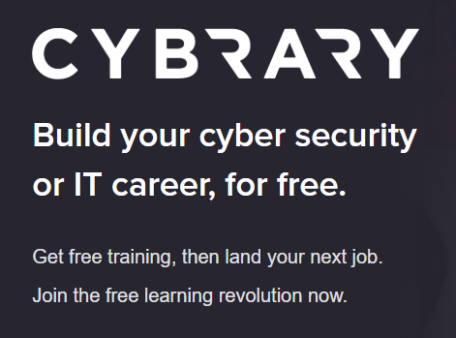
cybrary.it
Cybrary is an online resource containing dozens of prep courses.
Cybrary contains information on many Infosec topics and has coherent, guided programs for the self learner.

Slide 17
Introductions
Introduce yourself

Slide 18
Introduce yourself
Name
Major
Concentration (if any)
Personal interests or interests in specific Infosec topics

Slide 19
$SHELL
Part I – Basic Understanding

Slide 20
What is a Shell?
The shell is a program that takes commands from the keyboard (or other human interface hardware) and gives them to the operating system to perform.

Slide 21
Technical Position of the Shell
Low-Level High-Level
Logic Gates < Hardware < Kernel < Shell < Executable Programs

Slide 22
Interfaces
In the old days, the shell was the only user interface available on a Unix-like system such as Linux

Slide 23

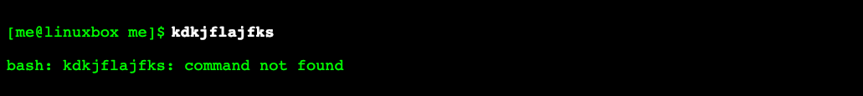
The Shell Prompt

Slide 24
Terminology
OS – Operating System
UNIX –family of multitasking, multiuser computer operating systems that derive from the original AT&T Unix
*NIX – Unix-like: includes Linux, Solaris, BSD, Mac OS, and original UNIX
DOS – ”Disk Operating System”, commonly used as an alias for the Windows OS

Slide 25
Practical Information
The *NIX shell will be used in demonstrations but we do not expect anyone to have a full understanding of every utility.
A *NIX shell is not required where there are alternative ways to complete the same task (though it may be significantly simpler to use a *NIX shell)
WSL is an alternative to a virtual box, or bare metal *NIX install but doesn’t always function comparably to an Ubuntu install
We recommend virtualbox for most of our members.
Kali Linux (preinstalled pentesting tools)
Ubuntu (popular distribution)

Slide 26
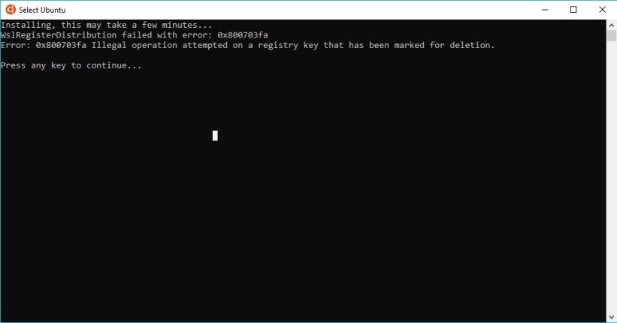
WSL - potential woes and differences between baremetal

Slide 27
UNIX
Unix systems Characterized by a modular design that is sometimes called the ”Unix Philosophy". The UNIX Philosophy entails that the operating system provides a set of simple tools that each performs a limited, well-defined function, with a unified filesystem (the UNIX filesystem) as the main means of communication, and a shell scripting and command language to combine the tools to perform complex workflows. Unix distinguishes itself from its predecessors as the first portable operating system: almost the entire operating system is written in the C programming language, thus allowing Unix to reach numerous platforms.

Slide 28
Q & A
With a sidenote

Slide 29
Other Information
If anyone wants to present their senior projects or speak on a topic, you may talk to the eboard about it and we will try to set a date.
If anyone is interested in becoming a team captain or taking up a leadership role in the club, speak with the eboard.
Our meetings are expected to be an hour long.
CTFs and other events may run longer.

Slide 30
Questions?
Next >> $SHELL Part II

Slide 31

Thank you
floridapoly.slack.com #cybersec_sit

